Slide 1
Link Layer Assisted Mobility Support Using SIP for Real-time Multimedia Communications
October 1, 2004
Myungchul Kim
mckim@cs.kaist.ac.kr

Slide 2
Contents
Introduction
Related Work
Problem Definition
Motivation
Proposed Scheme
Experiments
Conclusions & Future Work
References
Mobiwac 04

Slide 3
Introduction
Network layer mobility support
  Mobile IP, Cellular IP, HAWAII, etc.
  Transparent to upper layers, static home IP address
  Packet encapsulation overhead, security problem due to tunneling
Application layer mobility support
  Mobility Support using SIP [Wedlund 99]
  Deployable without additional sub systems or modifications on the existing network environment
  Dynamic temporal address whenever a network is changed
  Supports various types of mobility with a single protocol (e.g., personal mobility and service mobility in SIP)
  Generality for UDP based real-time applications
  IP address allocation due to a handoff takes several seconds [Dutta 01]→ inappropriate for real-time communications
Mobiwac 04

Slide 4
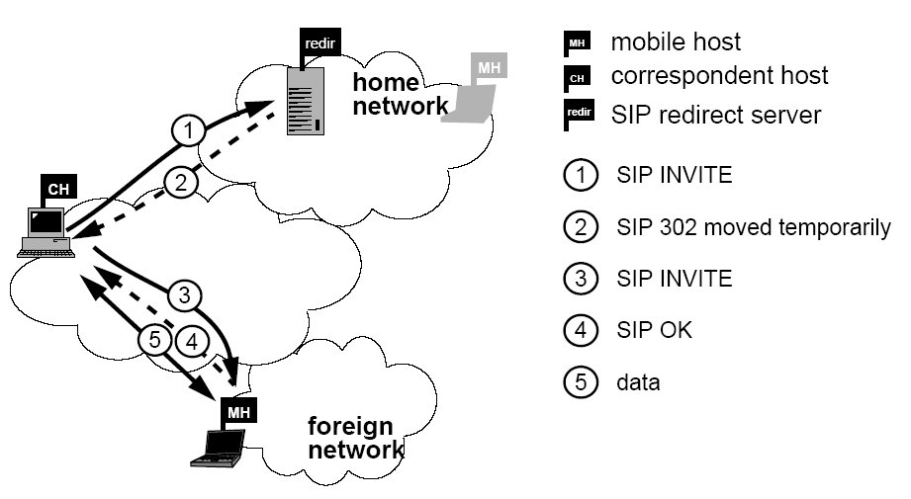
Related Work
Functions of SIP Terminal Mobility [Wedlund 99]
  Pre-call mobility
  Mid-call mobility
    Home location server manages current address of mobile host
    INVITE (455 bytes) RINGING (233 bytes) OK (381 bytes) ACK (216 bytes) messages [7]
    Using home SIP redirect or proxy server
Mobiwac 04

Slide 5
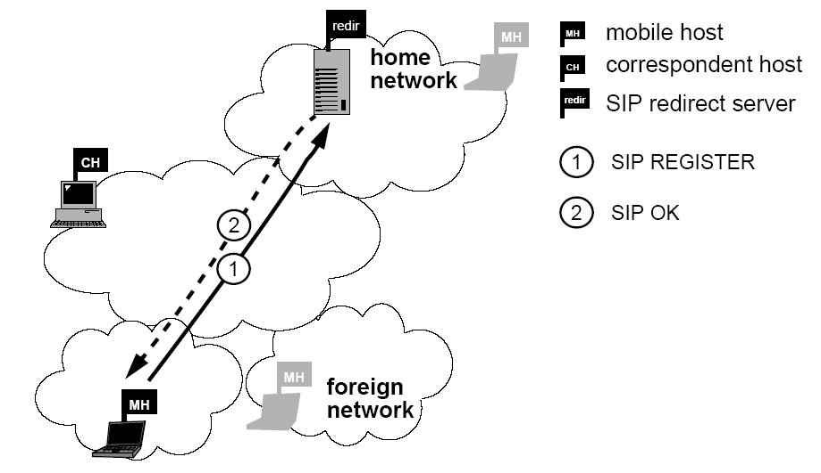
Related Work (cont’d)
Functions of SIP Terminal Mobility (cont’d)
  SIP terminal registration
    Fast registration to reduce disconnection in pre-call mobility
    About 150ms to complete whole re-registration procedure
    Regional mobility support by hierarchical registrars
  Error recovery
    To resolve simultaneous movements of both communication ends
Mobiwac 04

Slide 6
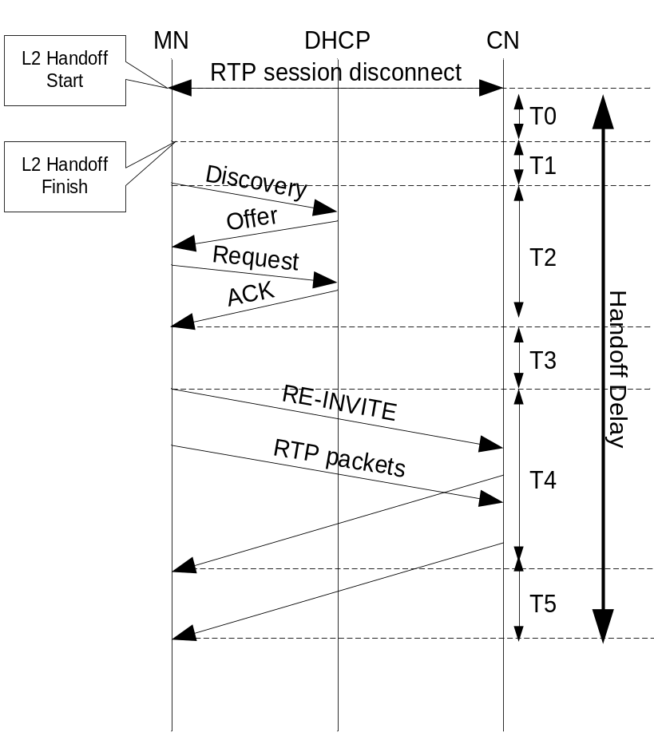
Problem Definition
Handoff delay of SIP mid-call mobility [12]
  Handoff Delay = ΣTn (n=0 to 5)
  Link layer handoff delay (T0)
  Movement Detection (T1)
  DHCP transaction (T2)
  Configuration time (T3)
  re-INVITE (T4)
  RTT/2 (T5)
  DHCP [2]: T2 > 1 sec,
  DRCP [8]: T2 = 100 ~ 180 ms [7,10]
  Total handoff delay of SIP mid-call mobility is not adoptable to real-time applications
< SIP Mobility Handoff Flow >
Mobiwac 04

Slide 7
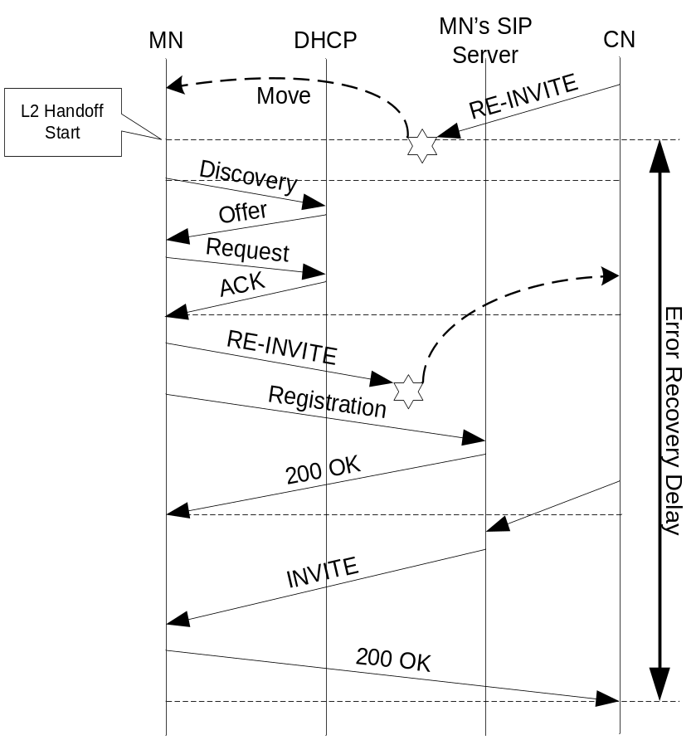
Problem Definition (cont’d)
Simultaneous movement Problem
  Total registration delay = address allocation time + SIP home registration time + re-INVITE time
  Error recovery latency = several hundred ms ~ a few seconds
  INVITE retransmission takes much time as far as home network is
< SIP Mobility Error Recovery >
Mobiwac 04

Slide 8
Motivation
To improve SIP mid-call terminal mobility
  Reduce handoff delay of mid-call mobility by removing address allocation time (T2) and re-INVITE delay (T4)
  Reduce error recovery latency due to simultaneous movement problem
Proposal for enhancement
  Application layer uses link layer (L2) information to reduce the handoff latency
  Predictive Address Reservation with SIP (PAR-SIP) scheme to perform the address allocation procedure and SIP session renewal before a handoff
Mobiwac 04

Slide 9
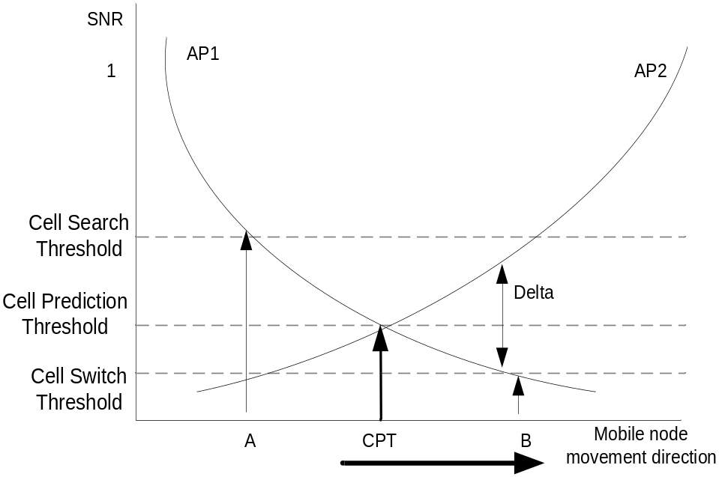
Proposed scheme: PAR-SIP
Link layer assisted handoff prediction
  Build link layer information by scanning neighbor access points (AP) at wireless LAN [15, 16, 17]
  Select predictive AP and start proactive handoff procedure at CPT
< Handoff between AP1 and AP2 >
Mobiwac 04

Slide 10
Proposed scheme: PAR-SIP (cont’d)
Movement detection in MN and BS
  MN’s Mobility Manager (MM) manages AP list of current subnet (e.g.,shadow block)
  MN sends reservation request if MAC address of predictive AP does not exist in AP list (movement detection delay decreases)
  BS’s MM manages neighbor BS information
  BS replies corresponding AP list for subnet of a reserved address
Base station number | AP MAC address | Network ID
BS1 | 00:39:99:82:23:54 | 203.101.23.0/24
 | 00:34:94:12:23:52
BS2 | 00:30:28:85:21:51 | 203.101.23.0/24
BS3 | 00:39:19:02:28:50 | 203.101.22.0/24
< Neighbor BS Information table>
Mobiwac 04

Slide 11
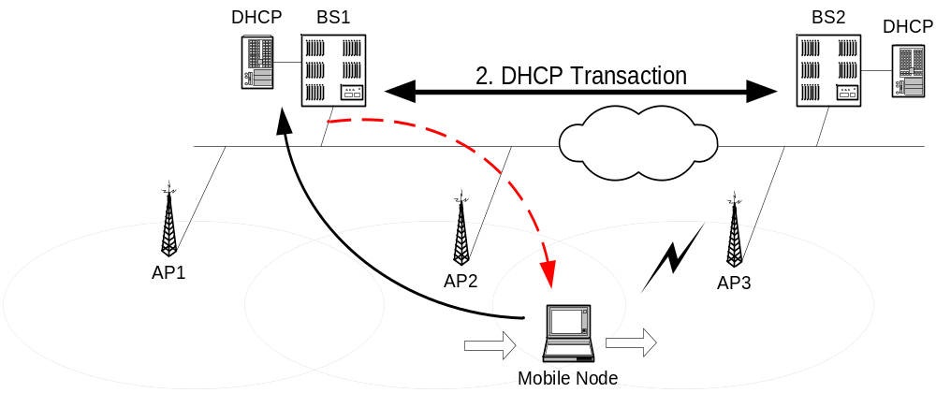
Proposed scheme: PAR-SIP (cont’d)
Address Reservation
  MN requests address reservation to a new BS through a current BS
  Address reservation is done before link layer handoff begins
  Defined messages: RSVREQ, RSVACK, RSVNACK, L2HO and TIMEOUT
< IP address reservation procedure >
Mobiwac 04

Slide 12
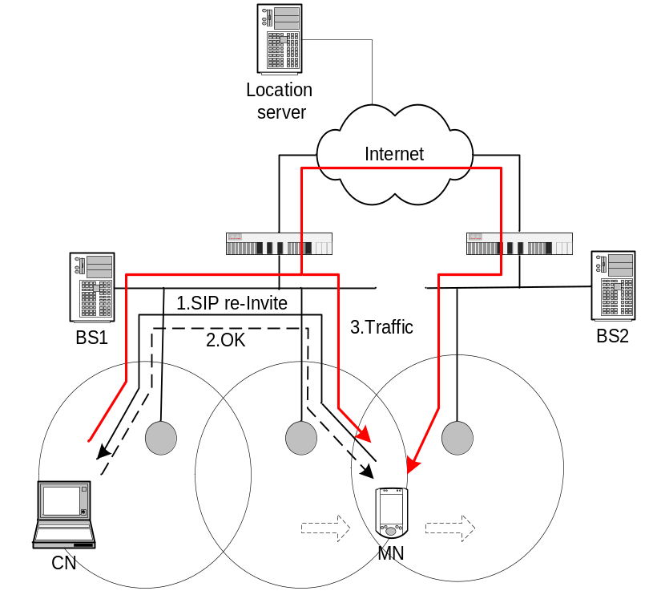
Proposed scheme: PAR-SIP (cont’d)
Advance re-INVITE to a peer with a reserved IP address
  Send re-INVITE to a CN with a reserved address before link layer handoff starts
  A CN sends packets to a current address and a newly invited address
  Solve simultaneous movement problem by alerting new address before handoff
  Reduce packet loss during handoff with bi-casting
< Bi-casting from CN >
Mobiwac 04

Slide 13
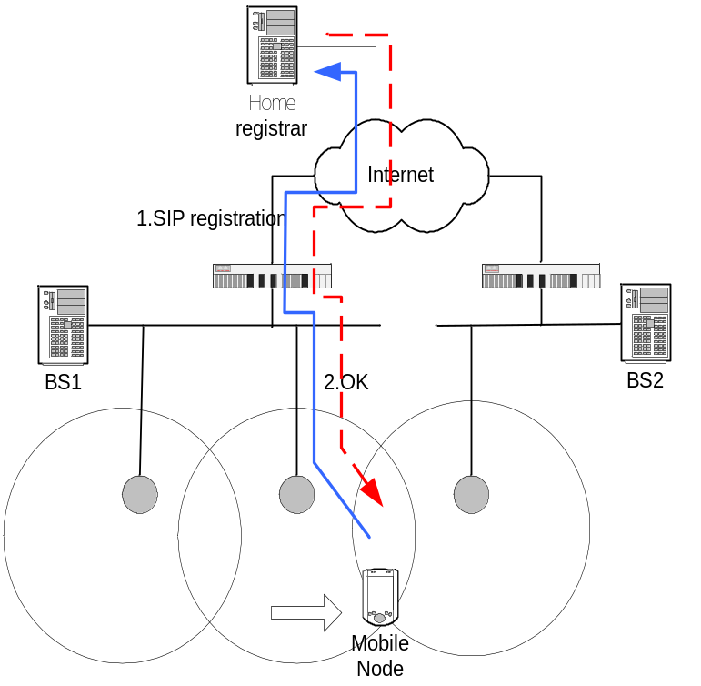
Proposed scheme: PAR-SIP (cont’d)
Advance registration procedure
  Reduce registration delay after handoff
  Two addresses (current IP address and reserved one) are temporarily bound with single user.
  Increase reachability of a MN in pre-call mobility because location server always a valid contact address
  Fast error recovery from advance registration
< Advance registration >
Mobiwac 04

Slide 14
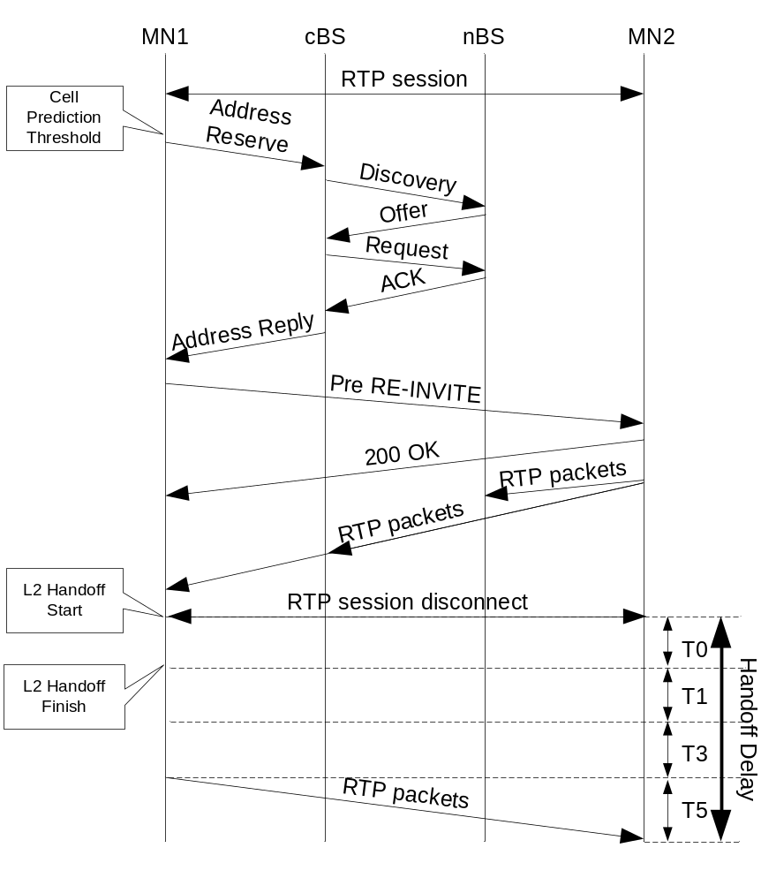
Proposed scheme: PAR-SIP (cont’d)
Handoff delay of PAR-SIP mid-call mobility
  PAR-SIP handoff delay
  = ΣTn ( n=0,1,3,5) < SIP handoff delay
  DHCP transaction time(T2) and SIP re-INVITE procedure time (T4) are removed
  Movement detection time (T1) is diminished
  T0,T3 and T5 is same as SIP terminal mobility
< PAR-SIP Mobility handoff flow >
Mobiwac 04

Slide 15
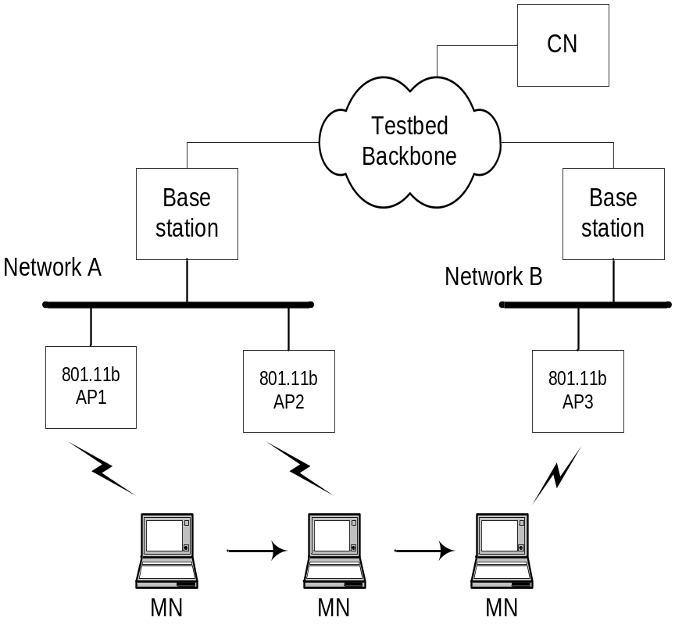
Experiments
Implementation environment
  Base Station
    Pentium-350Mhz PC
    Access Point: Prism2 card with HostAP driver [14]
  Mobile Node
    Pentium-800Mhz Tablet
    Lucent WaveLAN card
    DHCP client 1.3.22 (ISC)
  DHCP Server (in BS)
    DHCP 3.3a[18]
  SIP Application
    Linphone 0.9.0 [20] in MN and CN
  Operating System
    Linux Redhat 7.2 (2.4.7-10)
< Testbed Diagram >
Mobiwac 04

Slide 16
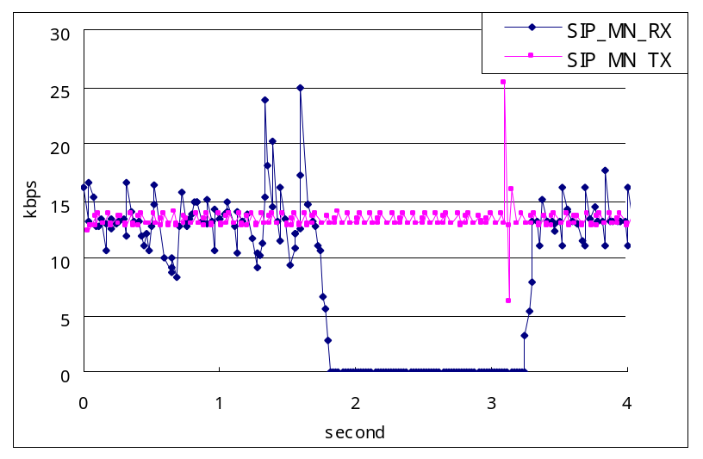
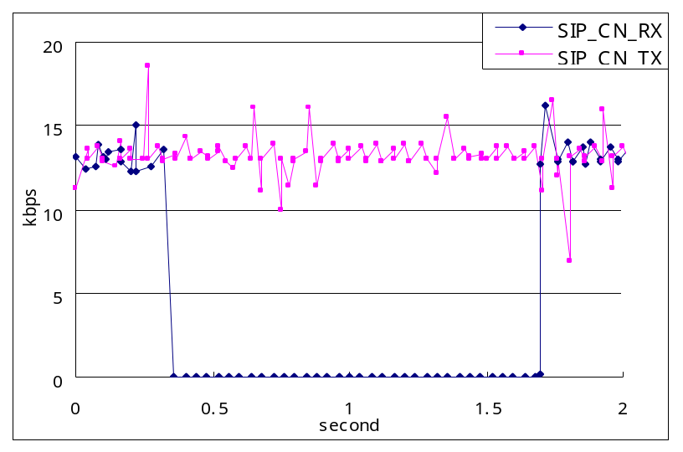
Experiments (cont’d)
Handoff Delay of Conventional SIP Mobility
  SIP_Handoff_Delay = Σ Tn ( n=0 to 5) = 50 ms +5 ms + 1.35 sec + 10 ms + 10 ms + RTT/2 ≅ 1.4 s.
  Both nodes can not receive packets for 1.5 seconds. Rx delay of a MN is a little longer than that of a CN due to re-INVITE delay
< MN transmission rate during Handoff >
< CN transmission rate during Handoff >
Mobiwac 04

Slide 17
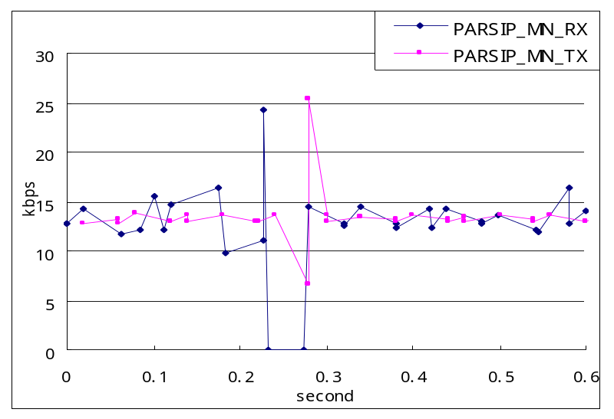
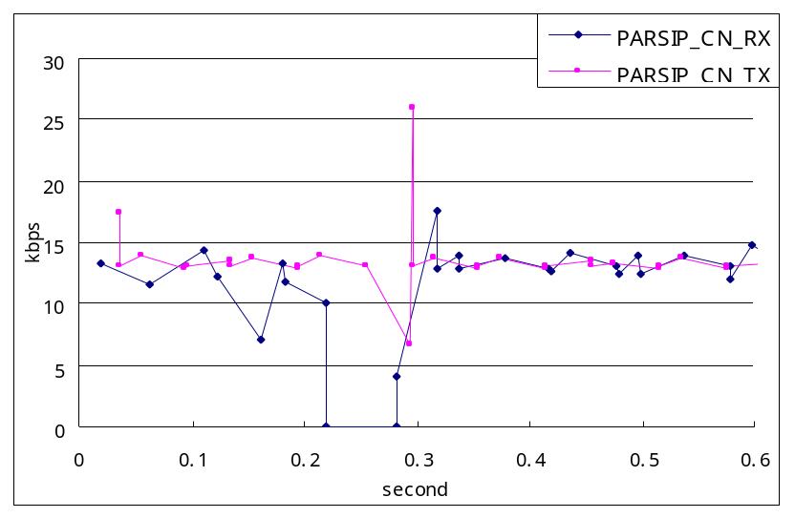
Experiments (cont’d)
Handoff Delay of PAR-SIP Mobility
  PAR-SIP_Handoff_Delay = Σ Tn ( n=0,1,3,5) = T0+T1+T3+T5 = 50 ms +1 ms + 7 ms + RTT/2 ≅ 60ms.
  A MN transmission rate is a little shorter than a CN because a CN keeps bi-casting for a MN during handoff
< MN transmission rate during Handoff >
< CN transmission rate during Handoff >
Mobiwac 04

Slide 18
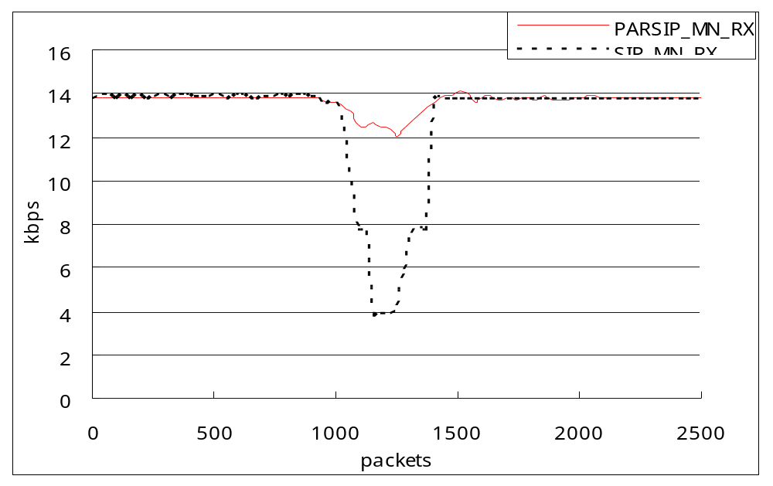
Experiments (cont’d)
Average transmission rate variation during handoff
  PAR-SIP Mobility shows better transmission rate due to handoff than existing SIP mobility while receiving 2500 packets.
  PAR-SIP only drops by 2 kbps during handoff
< Average transmission rate during handoff >
Mobiwac 04

Slide 19
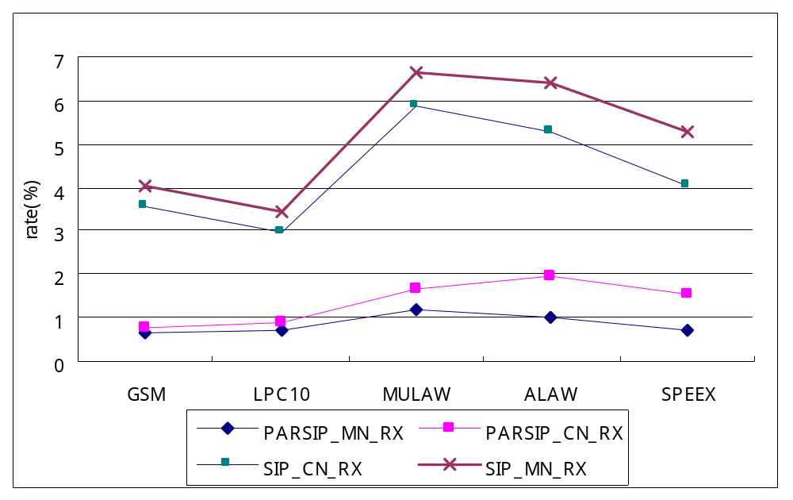
Experiments (cont’d)
Packet loss
  Low latency handoff and bi-casting can reduce the number of lost packets
  Packet loss of PAR-SIP mobility using all kinds of codecs shows about 1% of total packets comparing to 5% in conventional SIP mobility (handoff :4 times/sec)
< Packet loss rate Comparison>
Mobiwac 04

Slide 20
Conclusion & Future Work
Conclusion
  Conventional approach of SIP showed high handoff latency that is not proper to real-time communication
  PAR-SIP mobility reduces total handoff delay to about 60ms by reserving an IP address and requesting re-INVITE in advance
  PAR-SIP mobility also reduces packet loss
  PAR-SIP mobility can solve simultaneous movement problem with advance re-INVITE and registration
  Real-time communication can be available using application mobility
Future work
  Develop superior algorithm to predict precisely potential AP
  Measure error recovery delay using PAR-SIP
  Implement advance resource reservation using RSVP in MM of BS
Mobiwac 04

Slide 21
References
[1] H. Schulzrinne et al, "SIP: Session Initiation Protocol”, RFC 3261 IETF, June 2002.
[2] R. Droms., "Dynamic Host Configuration Protocol”, RFC 2131 IETF, Mar. 1997.
[3] C. Perkins., "IP mobility support," RFC 2002 IETF Oct. 1996.
[4] C. Perkins and D. Johnson., "Route optimization in mobile IP" Internet Draft, IETF, Feb. 1999.
[5] Elin Wedlund, H. Schulzrinne., "Mobility Support using SIP" IEEE/ACM Multimedia conference WOWMOM 1999.
[6] Faramak Vakil, A. Dutta, J.C Chen, S. Bava, Y.Sobatake, Henning Schulzrinne, "Mobility Requirements in SIP environment”,Internet Draft, IETF Work in progress.
[7] Ashutosh Dutta et al, “Application Layer Mobility Management Scheme for Wireless Internet”
[8] A.Mcauley, S.Das, S.Baba et al, “Dynamic Registration and Configuration Protocol” draft-itsumo-drcp-01.txt, IETF July 2000
[9] Melody Moh, “Mobile IP Telephony”, IEEE 1999
[10] David Famolari, “Performance Evaluation of ITSUMO Mobility Protocol for RTP/UDP Multimedia Session Across Subnet Boundaries”, ICC 2001
[11] Baba. S et al, “Implementing a testbed for mobile multimedia”, GLOBECOM 2001
[12] Ted. K et al, “Mobility Management for VoIP service: Mobile IP vs. SIP”, IEEE Wireless Communications, Oct. 2002
[13] O.Casals, et. al., "Performance evaluation of the post-registration method, a low latency handoff in MIPv4 ”, ICC '03. IEEE International Conference on , Volume: 1 , pp.522 -526, 2003.
[14] Host AP Driver - http://hostap.epitest.fi/.
[15] ANSI/IEEE Std 802.11, 1999 Edition.
[16] Lucent Technologies Inc., “Roaming With WaveLAN/IEEE 802.11”, WaveLAN Technical Bulletin 021/A, Dec. 1998.
[17] Lucent Technologies Inc., “IEEE 802.11 Channel Selection Guidelines”, WaveLAN Technical Bulletin 003/A, Nov. 1998.
[18] DHCP server- dhcpd. http://www.isc.org/products/DHCP/.
[19] Prism dump - http://developer.axis.com/software/tools/
[20] Linphone - http://www.linphone.org/
[21] A. G. Valk, “Cellular IP: A new approach to internet host mobility”, ACM Computer Communication Review, Vol. 29, pp. 50-65, Jan. 1999.
[22] R. Ramjee, et. al., “HAWAII: A domain-based approach for supporting mobility in wide-area wireless networks”, in International Conference on Network Protocols(ICNP), Nov. 1999.
Mobiwac 04

Slide 22
Thank You!
Mobiwac 04

